Slide 1
Playfair Cipher

Slide 2
Encryption
Write a program to encrypt the plain text “pay more money” using the Playfair cipher where the key is “identical”
Plain text: pay more money
Key: identical
Cipher text: ???

Slide 3
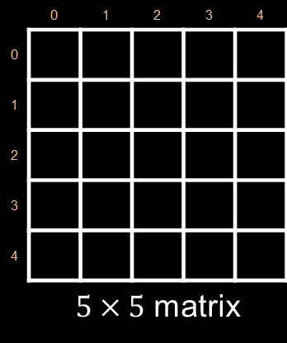

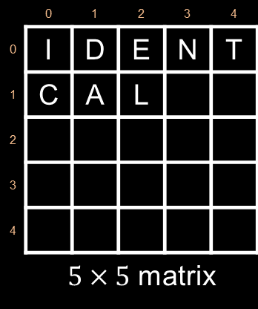

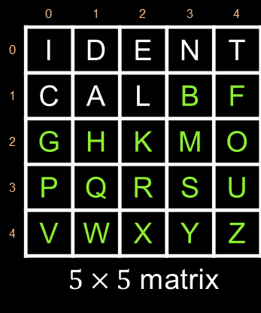
Key : identical
 | 0 | 1 | 2 | 3 | 4
0
1
2
3
4
 | $5×5$ matrix
 | 0 | 1 | 2 | 3 | 4
0 | I | D | E | N | T
1 | C | A | L
2
3
4
 | $5×5$ matrix
 | 0 | 1 | 2 | 3 | 4
0 | I | D | E | N | T
1 | C | A | L | B | F
2 | G | H | K | M | O
3 | P | Q | R | S | U
4 | V | W | X | Y | Z
 | $5×5$ matrix
Plain text : Paymoremoney
Plain text
$$\left(\begin{matrix}\begin{matrix}P_{1} & P_{2}\end{matrix} & \begin{matrix}P_{3} & P_{4}\end{matrix} \end{matrix} \begin{matrix} P_{5} & P_{6}\end{matrix}\right)$$
$$\left(\begin{matrix}\begin{matrix}p a & y m & o r\end{matrix} & \begin{matrix}e m & o n & e y\end{matrix}\end{matrix}\right)$$
$$\left(\begin{matrix}\begin{matrix}P_{11} P_{12} & P_{21}P_{22} & P_{31}P_{32}\end{matrix} & P_{41}P_{42} \end{matrix}P_{51}P_{52}{ P}_{61}P_{62}\right)$$

Slide 4






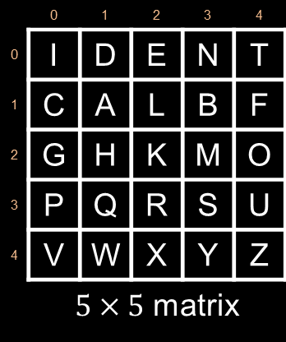
 | 0 | 1 | 2 | 3 | 4
0 | I | D | E | N | T
1 | C | A | L | B | F
2 | G | H | K | M | O
3 | P | Q | R | S | U
4 | V | W | X | Y | Z
 | $5×5$ matrix
Cipher text
$$\left(\begin{matrix}\begin{matrix}C_{1} & C_{2}\end{matrix} & \begin{matrix}C_{3} & C_{4}\end{matrix}\end{matrix} \begin{matrix} C_{5} & C_{6}\end{matrix}\right)$$
Matrix
$$\left(\begin{matrix}\begin{matrix}C_{11} C_{12} & C_{21}C_{22} & C_{31}C_{32}\end{matrix} & C_{41}C_{42} \end{matrix}C_{51}C_{52}{ C}_{61}C_{62}\right)$$
$$\left(\begin{matrix}\begin{matrix}Q C & C_{21}C_{22} & C_{31}C_{32}\end{matrix} & C_{41}C_{42} \end{matrix}C_{51}C_{52}{ C}_{61}C_{62}\right)$$
$$P_{1}=P_{11} P_{12}=p a$$
$$C_{11}=Matrix\left[row of P_{11}\right]\left[column of P_{12}\right]$$
$$C_{11}=Matrix\left[3\right]\left[1\right]$$
$C_{11}=$ Q
$$C_{12}=Matrix\left[row of P_{12}\right]\left[column of P_{11}\right]$$
$$C_{12}=Matrix\left[1\right]\left[0\right]$$
$C_{12}=$ C

Slide 5
 | 0 | 1 | 2 | 3 | 4
0 | I | D | E | N | T
1 | C | A | L | B | F
2 | G | H | K | M | O
3 | P | Q | R | S | U
4 | V | W | X | Y | Z
 | $5×5$ matrix
Cipher text
$$\left(\begin{matrix}\begin{matrix}C_{1} & C_{2}\end{matrix} & \begin{matrix}C_{3} & C_{4}\end{matrix}\end{matrix} \begin{matrix} C_{5} & C_{6}\end{matrix}\right)$$
Matrix
$$\left(\begin{matrix}\begin{matrix}C_{11} C_{12} & C_{21}C_{22} & C_{31}C_{32}\end{matrix} & C_{41}C_{42} \end{matrix}C_{51}C_{52}{ C}_{61}C_{62}\right)$$
$$\left(\begin{matrix}\begin{matrix}Q C & C_{21}C_{22} & C_{31}C_{32}\end{matrix} & C_{41}C_{42} \end{matrix}C_{51}C_{52}{ C}_{61}C_{62}\right)$$
$$P_{1}=P_{11} P_{12}=p a$$
$$C_{11}=Matrix\left[row of P_{11}\right]\left[column of P_{12}\right]$$
$$C_{11}=Matrix\left[3\right]\left[1\right]$$
$C_{11}=$ Q
$$C_{12}=Matrix\left[row of P_{12}\right]\left[column of P_{11}\right]$$
$$C_{12}=Matrix\left[1\right]\left[0\right]$$
$C_{12}=$ C

Slide 6






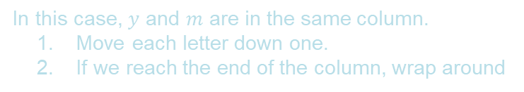
 | 0 | 1 | 2 | 3 | 4
0 | I | D | E | N | T
1 | C | A | L | B | F
2 | G | H | K | M | O
3 | P | Q | R | S | U
4 | V | W | X | Y | Z
 | $5×5$ matrix
Cipher text
$$\left(\begin{matrix}\begin{matrix}C_{1} & C_{2}\end{matrix} & \begin{matrix}C_{3} & C_{4}\end{matrix}\end{matrix} \begin{matrix} C_{5} & C_{6}\end{matrix}\right)$$
Matrix
$$\left(\begin{matrix}\begin{matrix}C_{11} C_{12} & C_{21}C_{22} & C_{31}C_{32}\end{matrix} & C_{41}C_{42} \end{matrix}C_{51}C_{52}{ C}_{61}C_{62}\right)$$
$$\left(\begin{matrix}\begin{matrix}Q C & N S & C_{31}C_{32}\end{matrix} & C_{41}C_{42} \end{matrix}C_{51}C_{52}{ C}_{61}C_{62}\right)$$
In this case, $y$ and $m$ are in the same column.
Move each letter down one.
If we reach the end of the column, wrap around
$$P_{2}=P_{21} P_{22}=y m$$
$$C_{21}=Matrix\left[\left(row of P_{21}+1\right)\%5\right]\left[column of P_{21}\right]$$
$$C_{21}=Matrix\left[0\right]\left[3\right]$$
$C_{21}=$ N
$$C_{22}=Matrix\left[\left(row of P_{22}+1\right)\%5\right]\left[column of P_{21}\right]$$
$$C_{22}=Matrix\left[3\right]\left[3\right]$$
$C_{22}=$ S

Slide 7





 | 0 | 1 | 2 | 3 | 4
0 | I | D | E | N | T
1 | C | A | L | B | F
2 | G | H | K | M | O
3 | P | Q | R | S | U
4 | V | W | X | Y | Z
 | $5×5$ matrix
Cipher text
$$\left(\begin{matrix}\begin{matrix}C_{1} & C_{2}\end{matrix} & \begin{matrix}C_{3} & C_{4}\end{matrix}\end{matrix} \begin{matrix} C_{5} & C_{6}\end{matrix}\right)$$
Matrix
$$\left(\begin{matrix}\begin{matrix}C_{11} C_{12} & C_{21}C_{22} & C_{31}C_{32}\end{matrix} & C_{41}C_{42} \end{matrix}C_{51}C_{52}{ C}_{61}C_{62}\right)$$
$$\left(\begin{matrix}\begin{matrix}Q C & N S & K U\end{matrix} & C_{41}C_{42} \end{matrix}C_{51}C_{52}{ C}_{61}C_{62}\right)$$
$$P_{3}=P_{31} P_{32}=o r$$
$$C_{31}=Matrix\left[row of P_{31}\right]\left[column of P_{32}\right]$$
$$C_{31}=Matrix\left[2\right]\left[2\right]$$
$C_{31}=$ K
$$C_{32}=Matrix\left[row of P_{32}\right]\left[column of P_{31}\right]$$
$$C_{32}=Matrix\left[3\right]\left[4\right]$$
$C_{32}=$ U

Slide 8





 | 0 | 1 | 2 | 3 | 4
0 | I | D | E | N | T
1 | C | A | L | B | F
2 | G | H | K | M | O
3 | P | Q | R | S | U
4 | V | W | X | Y | Z
 | $5×5$ matrix
Cipher text
$$\left(\begin{matrix}\begin{matrix}C_{1} & C_{2}\end{matrix} & \begin{matrix}C_{3} & C_{4}\end{matrix}\end{matrix} \begin{matrix} C_{5} & C_{6}\end{matrix}\right)$$
Matrix
$$\left(\begin{matrix}\begin{matrix}C_{11} C_{12} & C_{21}C_{22} & C_{31}C_{32}\end{matrix} & C_{41}C_{42} \end{matrix}C_{51}C_{52}{ C}_{61}C_{62}\right)$$
$$\left(\begin{matrix}\begin{matrix}Q C & N S & K U\end{matrix} & N K \end{matrix}C_{51}C_{52}{ C}_{61}C_{62}\right)$$
$$P_{4}=P_{41} P_{42}=e m$$
$$C_{41}=Matrix\left[row of P_{41}\right]\left[column of P_{42}\right]$$
$$C_{41}=Matrix\left[0\right]\left[3\right]$$
$C_{41}=$ N
$$C_{42}=Matrix\left[row of P_{42}\right]\left[column of P_{41}\right]$$
$$C_{42}=Matrix\left[2\right]\left[2\right]$$
$C_{42}=$ K

Slide 9





 | 0 | 1 | 2 | 3 | 4
0 | I | D | E | N | T
1 | C | A | L | B | F
2 | G | H | K | M | O
3 | P | Q | R | S | U
4 | V | W | X | Y | Z
 | $5×5$ matrix
Cipher text
$$\left(\begin{matrix}\begin{matrix}C_{1} & C_{2}\end{matrix} & \begin{matrix}C_{3} & C_{4}\end{matrix}\end{matrix} \begin{matrix} C_{5} & C_{6}\end{matrix}\right)$$
Matrix
$$\left(\begin{matrix}\begin{matrix}C_{11} C_{12} & C_{21}C_{22} & C_{31}C_{32}\end{matrix} & C_{41}C_{42} \end{matrix}C_{51}C_{52}{ C}_{61}C_{62}\right)$$
$$\left(\begin{matrix}\begin{matrix}Q C & N S & K U\end{matrix} & N K \end{matrix}M T{ C}_{61}C_{62}\right)$$
$$P_{5}=P_{51} P_{52}=o n$$
$$C_{51}=Matrix\left[row of P_{51}\right]\left[column of P_{52}\right]$$
$$C_{51}=Matrix\left[2\right]\left[3\right]$$
$C_{51}=$ M
$$C_{52}=Matrix\left[row of P_{52}\right]\left[column of P_{51}\right]$$
$$C_{52}=Matrix\left[0\right]\left[4\right]$$
$C_{52}=$ T

Slide 10






 | 0 | 1 | 2 | 3 | 4
0 | I | D | E | N | T
1 | C | A | L | B | F
2 | G | H | K | M | O
3 | P | Q | R | S | U
4 | V | W | X | Y | Z
 | $5×5$ matrix
Cipher text
$$\left(\begin{matrix}\begin{matrix}C_{1} & C_{2}\end{matrix} & \begin{matrix}C_{3} & C_{4}\end{matrix}\end{matrix} \begin{matrix} C_{5} & C_{6}\end{matrix}\right)$$
Matrix
$$\left(\begin{matrix}\begin{matrix}C_{11} C_{12} & C_{21}C_{22} & C_{31}C_{32}\end{matrix} & C_{41}C_{42} \end{matrix}C_{51}C_{52}{ C}_{61}C_{62}\right)$$
$$\left(\begin{matrix}\begin{matrix}Q C & N S & K U\end{matrix} & N K \end{matrix}M T N X\right)$$
$$P_{6}=P_{61} P_{62}=e y$$
$$C_{61}=Matrix\left[row of P_{61}\right]\left[column of P_{62}\right]$$
$$C_{61}=Matrix\left[0\right]\left[3\right]$$
$C_{61}=$ N
$$C_{62}=Matrix\left[row of P_{62}\right]\left[column of P_{61}\right]$$
$$C_{62}=Matrix\left[4\right]\left[2\right]$$
$C_{62}=$ X
Cipher text : QCNSKUNKMTNX

Slide 11
Encryption
Write a program to encrypt the plain text “ballon” using the Playfair cipher where the key is “identical”
Plain text: ballon
Key: identical
Cipher text: ???

Slide 12



 | 0 | 1 | 2 | 3 | 4
0 | I | D | E | N | T
1 | C | A | L | B | F
2 | G | H | K | M | O
3 | P | Q | R | S | U
4 | V | W | X | Y | Z
 | $5×5$ matrix
Cipher text
$$\left(\begin{matrix}\begin{matrix}C_{1} & C_{2}\end{matrix} & \begin{matrix}C_{3} & C_{4}\end{matrix}\end{matrix}\right)$$
$$\left(\begin{matrix}\begin{matrix}C_{11} C_{12} & C_{21}C_{22} & C_{31}C_{32}\end{matrix} & C_{41}C_{42}\end{matrix}\right)$$
Matrix
Plain text : Ballon
Plain text
$$\left(\begin{matrix}P_{1} & P_{2}\end{matrix} \begin{matrix} P_{3} & P_{4}\end{matrix}\right)$$
$$\left(\begin{matrix}\begin{matrix}b a & l x & l o\end{matrix} & n x\end{matrix}\right)$$
$$\left(\begin{matrix}\begin{matrix}P_{11} P_{12} & P_{21}P_{22} & P_{31}P_{32}\end{matrix} & P_{41}P_{42}\end{matrix}\right)$$

Slide 13


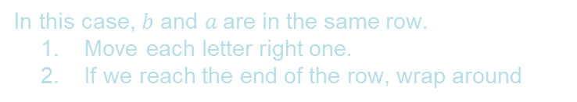




 | 0 | 1 | 2 | 3 | 4
0 | I | D | E | N | T
1 | C | A | L | B | F
2 | G | H | K | M | O
3 | P | Q | R | S | U
4 | V | W | X | Y | Z
 | $5×5$ matrix
Cipher text
$$\left(\begin{matrix}\begin{matrix}C_{1} & C_{2}\end{matrix} & \begin{matrix}C_{3} & C_{4}\end{matrix}\end{matrix}\right)$$
$$\left(\begin{matrix}\begin{matrix}C_{11} C_{12} & C_{21}C_{22} & C_{31}C_{32}\end{matrix} & C_{41}C_{42}\end{matrix}\right)$$
Matrix
$$\left(\begin{matrix}\begin{matrix}F L & C_{21}C_{22} & C_{31}C_{32}\end{matrix} & C_{41}C_{42}\end{matrix}\right)$$
In this case, $b$ and $a$are in the same row.
Move each letter right one.
If we reach the end of the row, wrap around
$$P_{1}=P_{11} P_{12}=b a$$
$$C_{11}=Matrix\left[row of P_{11}\right]\left[\left(column of P_{11}+1\right)\%5\right]$$
$$C_{11}=Matrix\left[1\right]\left[4\right]$$
$C_{11}=$ F
$$C_{12}=Matrix\left[row of P_{11}\right]\left[\left(column of P_{12}+1\right)\%5\right]$$
$$C_{12}=Matrix\left[1\right]\left[2\right]$$
$C_{12}=$ L

Slide 14


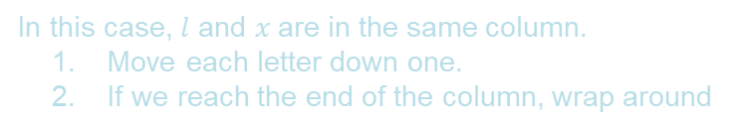




 | 0 | 1 | 2 | 3 | 4
0 | I | D | E | N | T
1 | C | A | L | B | F
2 | G | H | K | M | O
3 | P | Q | R | S | U
4 | V | W | X | Y | Z
 | $5×5$ matrix
Cipher text
$$\left(\begin{matrix}\begin{matrix}C_{1} & C_{2}\end{matrix} & \begin{matrix}C_{3} & C_{4}\end{matrix}\end{matrix}\right)$$
$$\left(\begin{matrix}\begin{matrix}C_{11} C_{12} & C_{21}C_{22} & C_{31}C_{32}\end{matrix} & C_{41}C_{42}\end{matrix}\right)$$
Matrix
$$\left(\begin{matrix}\begin{matrix}F L & K E & C_{31}C_{32}\end{matrix} & C_{41}C_{42}\end{matrix}\right)$$
In this case, $l$ and $x$are in the same column.
Move each letter down one.
If we reach the end of the column, wrap around
$$P_{2}=P_{21} P_{22}=l x$$
$$C_{21}=Matrix\left[(row of P_{21}+1)\%5\right]\left[column of P_{21}\right]$$
$$C_{21}=Matrix\left[2\right]\left[2\right]$$
$C_{21}=$ K
$$C_{22}=Matrix\left[(row of P_{22}+1)\%5\right]\left[column of P_{21}\right]$$
$$C_{22}=Matrix\left[0\right]\left[2\right]$$
$C_{22}=$ E

Slide 15






 | 0 | 1 | 2 | 3 | 4
0 | I | D | E | N | T
1 | C | A | L | B | F
2 | G | H | K | M | O
3 | P | Q | R | S | U
4 | V | W | X | Y | Z
 | $5×5$ matrix
Cipher text
$$\left(\begin{matrix}\begin{matrix}C_{1} & C_{2}\end{matrix} & \begin{matrix}C_{3} & C_{4}\end{matrix}\end{matrix}\right)$$
$$\left(\begin{matrix}\begin{matrix}C_{11} C_{12} & C_{21}C_{22} & C_{31}C_{32}\end{matrix} & C_{41}C_{42}\end{matrix}\right)$$
Matrix
$$\left(\begin{matrix}\begin{matrix}F L & K E & F K\end{matrix} & C_{41}C_{42}\end{matrix}\right)$$
$$P_{3}=P_{31} P_{32}=l o$$
$$C_{31}=Matrix\left[row of P_{31}\right]\left[column of P_{32}\right]$$
$$C_{31}=Matrix\left[1\right]\left[4\right]$$
$C_{31}=$ F
$$C_{32}=Matrix\left[row of P_{32}\right]\left[column of P_{31}\right]$$
$$C_{32}=Matrix\left[2\right]\left[2\right]$$
$C_{32}=$ K

Slide 16






 | 0 | 1 | 2 | 3 | 4
0 | I | D | E | N | T
1 | C | A | L | B | F
2 | G | H | K | M | O
3 | P | Q | R | S | U
4 | V | W | X | Y | Z
 | $5×5$ matrix
Cipher text
$$\left(\begin{matrix}\begin{matrix}C_{1} & C_{2}\end{matrix} & \begin{matrix}C_{3} & C_{4}\end{matrix}\end{matrix}\right)$$
$$\left(\begin{matrix}\begin{matrix}C_{11} C_{12} & C_{21}C_{22} & C_{31}C_{32}\end{matrix} & C_{41}C_{42}\end{matrix}\right)$$
Matrix
$$\left(\begin{matrix}\begin{matrix}F L & K E & F K\end{matrix} & E Y\end{matrix}\right)$$
$$P_{4}=P_{41} P_{42}=n x$$
$$C_{41}=Matrix\left[row of P_{41}\right]\left[column of P_{42}\right]$$
$$C_{41}=Matrix\left[0\right]\left[2\right]$$
$C_{41}=$ E
$$C_{42}=Matrix\left[row of P_{42}\right]\left[column of P_{41}\right]$$
$$C_{42}=Matrix\left[4\right]\left[3\right]$$
$C_{42}=$ Y
Cipher text : FLKEFKEY

Slide 17
Decryption
Write a program to decrypt the cipher text “flkefkey” using the Playfair cipher where the key is “identical”
Cipher text: flkefkey
Key: identical
Plain text: ???

Slide 18



 | 0 | 1 | 2 | 3 | 4
0 | I | D | E | N | T
1 | C | A | L | B | F
2 | G | H | K | M | O
3 | P | Q | R | S | U
4 | V | W | X | Y | Z
 | $5×5$ matrix
Plain text
$$\left(\begin{matrix}\begin{matrix}P_{1} & P_{2}\end{matrix} & \begin{matrix}P_{3} & P_{4}\end{matrix}\end{matrix}\right)$$
$$\left(\begin{matrix}\begin{matrix}P_{11} P_{12} & P_{21}P_{22} & P_{31}P_{32}\end{matrix} & P_{41}P_{42}\end{matrix}\right)$$
Matrix
Cipher text : flkefkey
Cipher text
$$\left(\begin{matrix}C_{1} & C_{2}\end{matrix} \begin{matrix} C_{3} & C_{4}\end{matrix}\right)$$
$$\left(\begin{matrix}\begin{matrix}f l & k e & f k\end{matrix} & e y\end{matrix}\right)$$
$$\left(\begin{matrix}\begin{matrix}C_{11} C_{12} & C_{21}C_{22} & C_{31}C_{32}\end{matrix} & C_{41}C_{42}\end{matrix}\right)$$

Slide 19


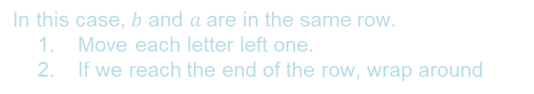




 | 0 | 1 | 2 | 3 | 4
0 | I | D | E | N | T
1 | C | A | L | B | F
2 | G | H | K | M | O
3 | P | Q | R | S | U
4 | V | W | X | Y | Z
 | $5×5$ matrix
Plain text
$$\left(\begin{matrix}\begin{matrix}P_{1} & P_{2}\end{matrix} & \begin{matrix}P_{3} & P_{4}\end{matrix}\end{matrix}\right)$$
$$\left(\begin{matrix}\begin{matrix}P_{11} P_{12} & P_{21}P_{22} & P_{31}P_{32}\end{matrix} & P_{41}P_{42}\end{matrix}\right)$$
Matrix
$$\left(\begin{matrix}\begin{matrix}B A & P_{21}P_{22} & P_{31}P_{32}\end{matrix} & P_{41}P_{42}\end{matrix}\right)$$
In this case, $b$ and $a$are in the same row.
Move each letter left one.
If we reach the end of the row, wrap around
$$C_{1}=C_{11} C_{12}=f l$$
$$P_{11}=Matrix\left[row of C_{11}\right]\left[\left(column of C_{11}−1\right)\%5\right]$$
$$P_{11}=Matrix\left[1\right]\left[3\right]$$
$P_{11}=$ B
$$P_{12}=Matrix\left[row of C_{11}\right]\left[\left(column of C_{12}−1\right)\%5\right]$$
$$P_{12}=Matrix\left[1\right]\left[1\right]$$
$P_{12}=$ A

Slide 20


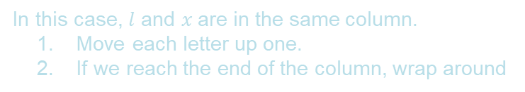




 | 0 | 1 | 2 | 3 | 4
0 | I | D | E | N | T
1 | C | A | L | B | F
2 | G | H | K | M | O
3 | P | Q | R | S | U
4 | V | W | X | Y | Z
 | $5×5$ matrix
Plain text
$$\left(\begin{matrix}\begin{matrix}P_{1} & P_{2}\end{matrix} & \begin{matrix}P_{3} & P_{4}\end{matrix}\end{matrix}\right)$$
$$\left(\begin{matrix}\begin{matrix}P_{11} P_{12} & P_{21}P_{22} & P_{31}P_{32}\end{matrix} & P_{41}P_{42}\end{matrix}\right)$$
Matrix
$$\left(\begin{matrix}\begin{matrix}B A & L X & P_{31}P_{32}\end{matrix} & P_{41}P_{42}\end{matrix}\right)$$
In this case, $l$ and $x$are in the same column.
Move each letter up one.
If we reach the end of the column, wrap around
$$C_{2}=C_{21} C_{22}=k e$$
$$P_{21}=Matrix\left[(row of C_{21}−1)\%5\right]\left[column of C_{21}\right]$$
$$P_{21}=Matrix\left[1\right]\left[2\right]$$
$P_{21}=$ L
$$P_{22}=Matrix\left[(row of C_{22}−1)\%5\right]\left[column of C_{21}\right]$$
$$P_{22}=Matrix\left[4\right]\left[2\right]$$
$P_{22}=$ X

Slide 21






 | 0 | 1 | 2 | 3 | 4
0 | I | D | E | N | T
1 | C | A | L | B | F
2 | G | H | K | M | O
3 | P | Q | R | S | U
4 | V | W | X | Y | Z
 | $5×5$ matrix
Plain text
$$\left(\begin{matrix}\begin{matrix}P_{1} & P_{2}\end{matrix} & \begin{matrix}P_{3} & P_{4}\end{matrix}\end{matrix}\right)$$
$$\left(\begin{matrix}\begin{matrix}P_{11} P_{12} & P_{21}P_{22} & P_{31}P_{32}\end{matrix} & P_{41}P_{42}\end{matrix}\right)$$
Matrix
$$\left(\begin{matrix}\begin{matrix}B A & L X & L O\end{matrix} & P_{41}P_{42}\end{matrix}\right)$$
$$C_{3}=C_{31} C_{32}=f k$$
$$P_{31}=Matrix\left[row of C_{31}\right]\left[column of C_{32}\right]$$
$$P_{31}=Matrix\left[1\right]\left[2\right]$$
$P_{31}=$ L
$$P_{32}=Matrix\left[row of C_{32}\right]\left[column of C_{31}\right]$$
$$P_{32}=Matrix\left[2\right]\left[4\right]$$
$P_{32}=$ O

Slide 22






 | 0 | 1 | 2 | 3 | 4
0 | I | D | E | N | T
1 | C | A | L | B | F
2 | G | H | K | M | O
3 | P | Q | R | S | U
4 | V | W | X | Y | Z
 | $5×5$ matrix
Plain text
$$\left(\begin{matrix}\begin{matrix}P_{1} & P_{2}\end{matrix} & \begin{matrix}P_{3} & P_{4}\end{matrix}\end{matrix}\right)$$
$$\left(\begin{matrix}\begin{matrix}P_{11} P_{12} & P_{21}P_{22} & P_{31}P_{32}\end{matrix} & P_{41}P_{42}\end{matrix}\right)$$
Matrix
$$\left(\begin{matrix}\begin{matrix}B A & L X & L O\end{matrix} & N X\end{matrix}\right)$$
$$C_{4}=C_{41} C_{42}=e y$$
$$P_{41}=Matrix\left[row of C_{41}\right]\left[column of C_{42}\right]$$
$$P_{41}=Matrix\left[0\right]\left[3\right]$$
$P_{41}=$ N
$$P_{42}=Matrix\left[row of C_{42}\right]\left[column of C_{41}\right]$$
$$P_{42}=Matrix\left[4\right]\left[2\right]$$
$P_{42}=$ X
Plain text : BALXLONX

Slide 23
Thanks!

